Slide 1
LOOK UP!
What do all journalism students need to know about our environment and how to achieve that?
Insights from the annual Dutch-Flemish teachers conference.
Harmen Groenhart
Fontys University of Applied Sciences
h.groenhart@fontys.nl

Slide 2
PERCHÉ
COSA
COME
QUANDO
CHI

Slide 3
WHY
WHAT
HOW
WHEN
WHO

Slide 4
WHY is this important?
WHAT knowledge?
HOW to we teach it?
WHEN do we start?
WHO ’s turn is it?
“…being able to properly follow and interpret all causes, consequences and measures regarding climate change requires new knowledge and insights.”
Dutch national profile for journalism education, 2023

Slide 5
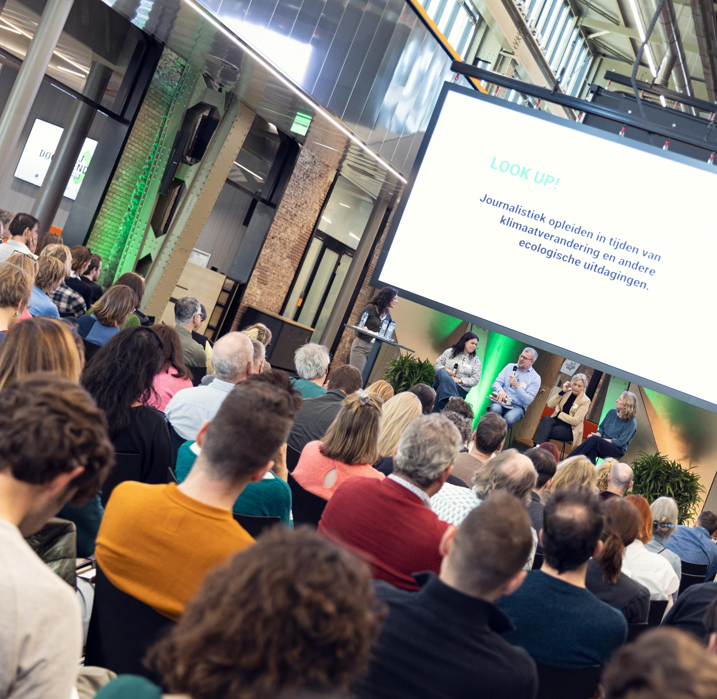
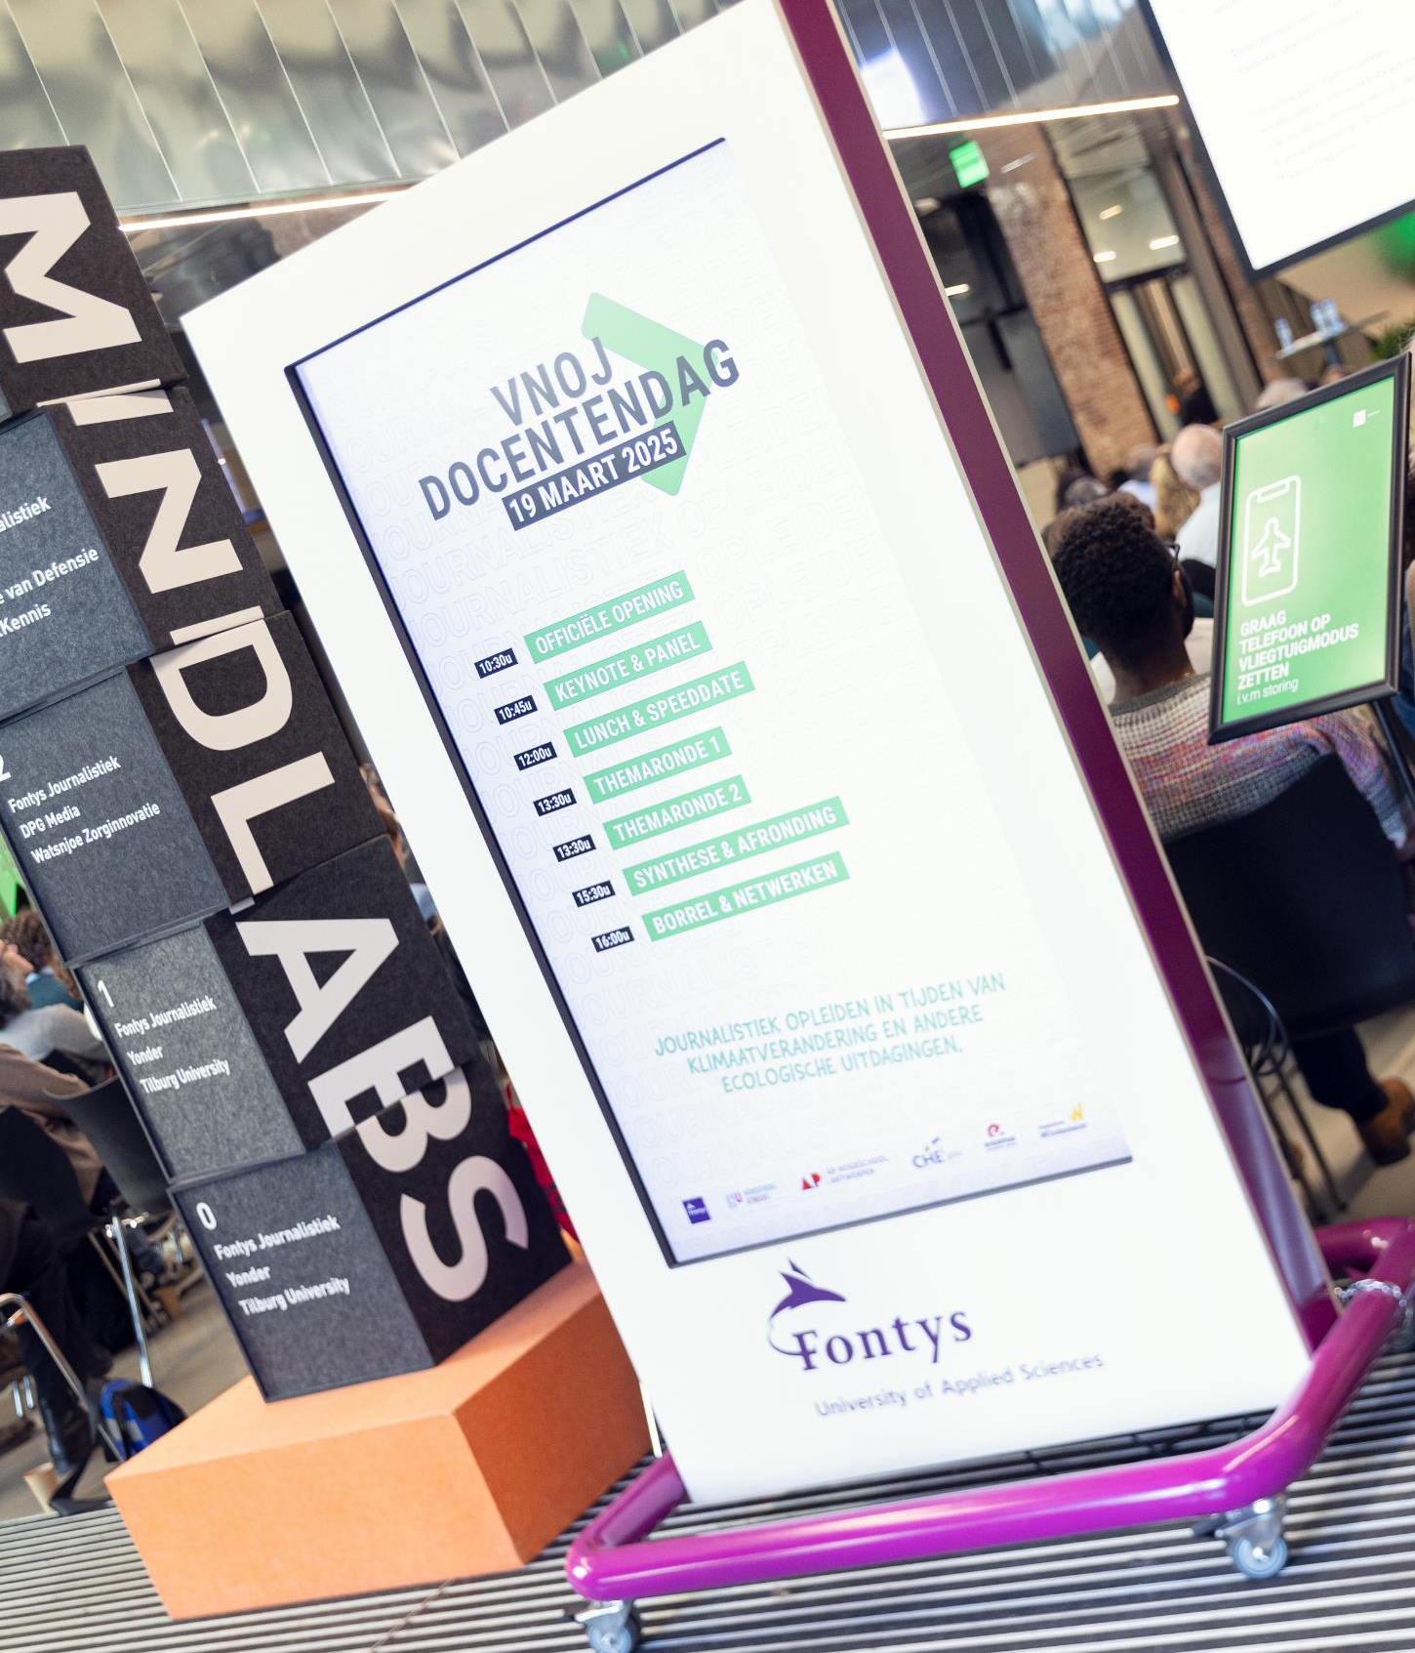
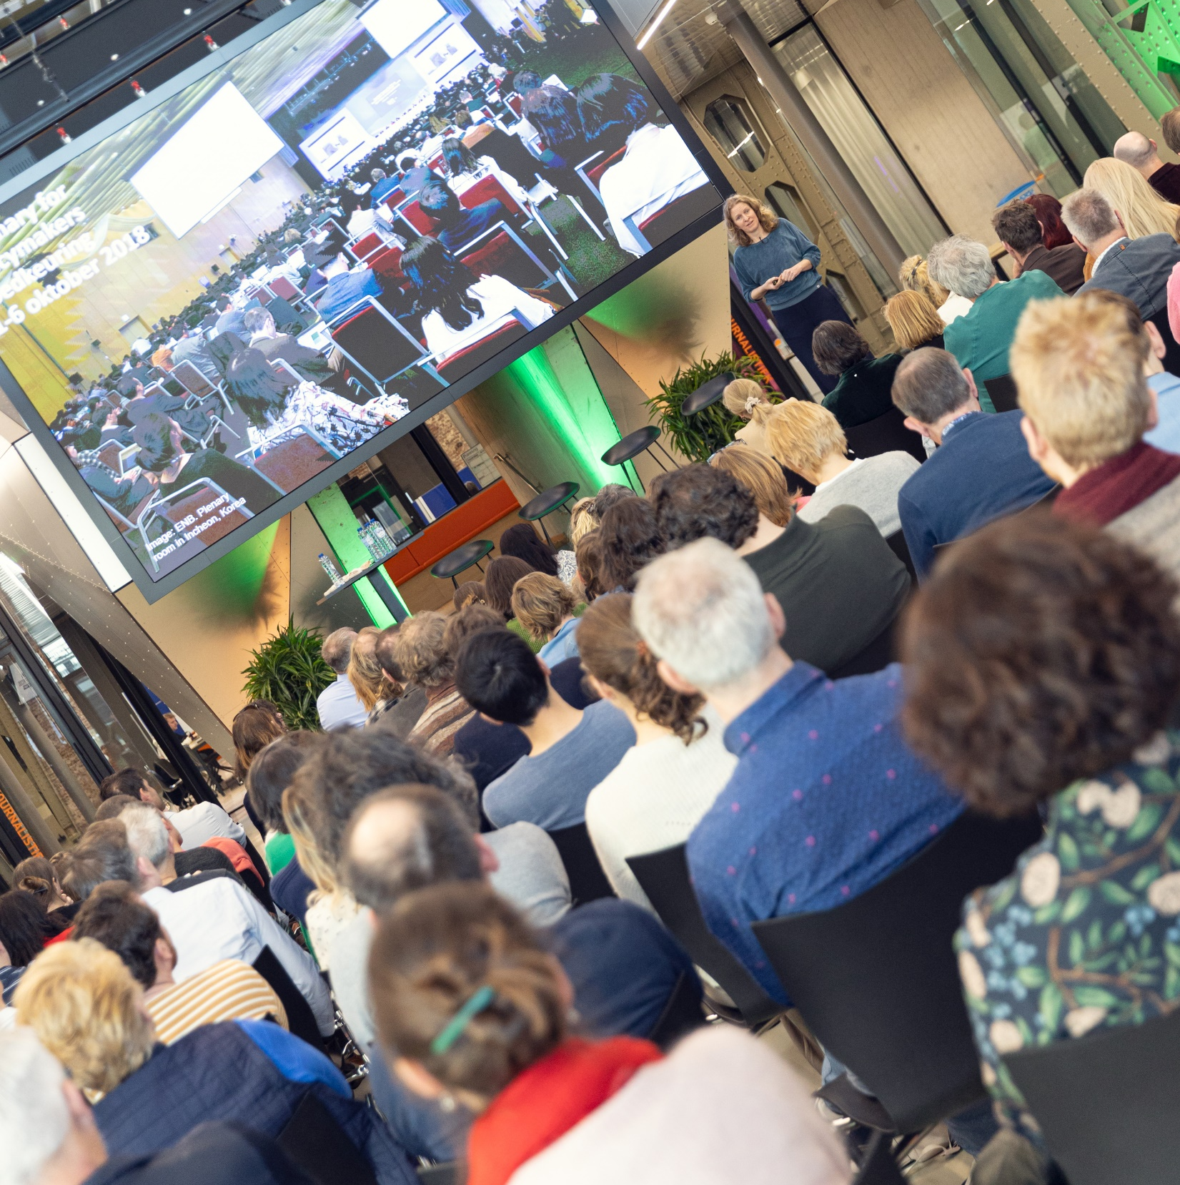
120 teachers from 10 J-schools in NL and BE
1 key note, 4 panel speakers, 4 inspiration sessions, 2 workshops, 5 training sesisons, 4 roundtables.

Slide 6
Heleen
de Coninck
Heleen
Ekker
Ward
Wijndelts
Isa
Hamerlinck

Slide 7
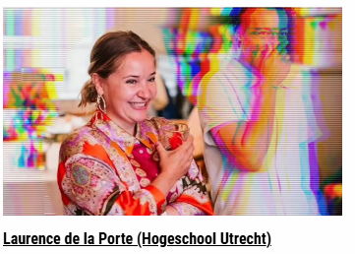
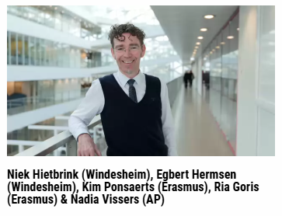

Slide 8
WHY?
o you must be able to recognize the news, know what is relevant and newsworthy.
o you have to be able to make connections with other domains; ecology is related to all other sub-editorial work.
o you have to be able to recognize when a source is deceiving you with false or simplistic narrative, you will go wrong if you do not have a basic understanding.
o climate issues are so existential and so long-term that it is potentially more important than other domains.

Slide 9
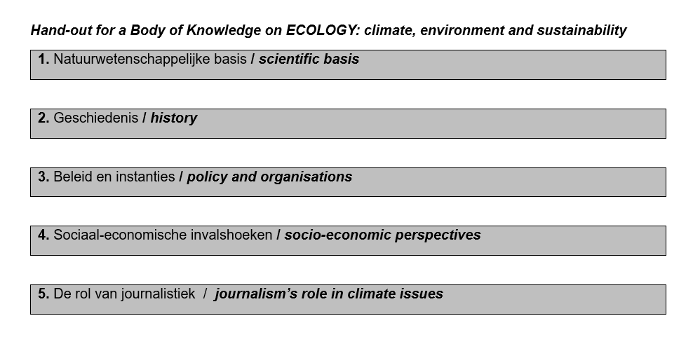
WHAT?

Slide 10
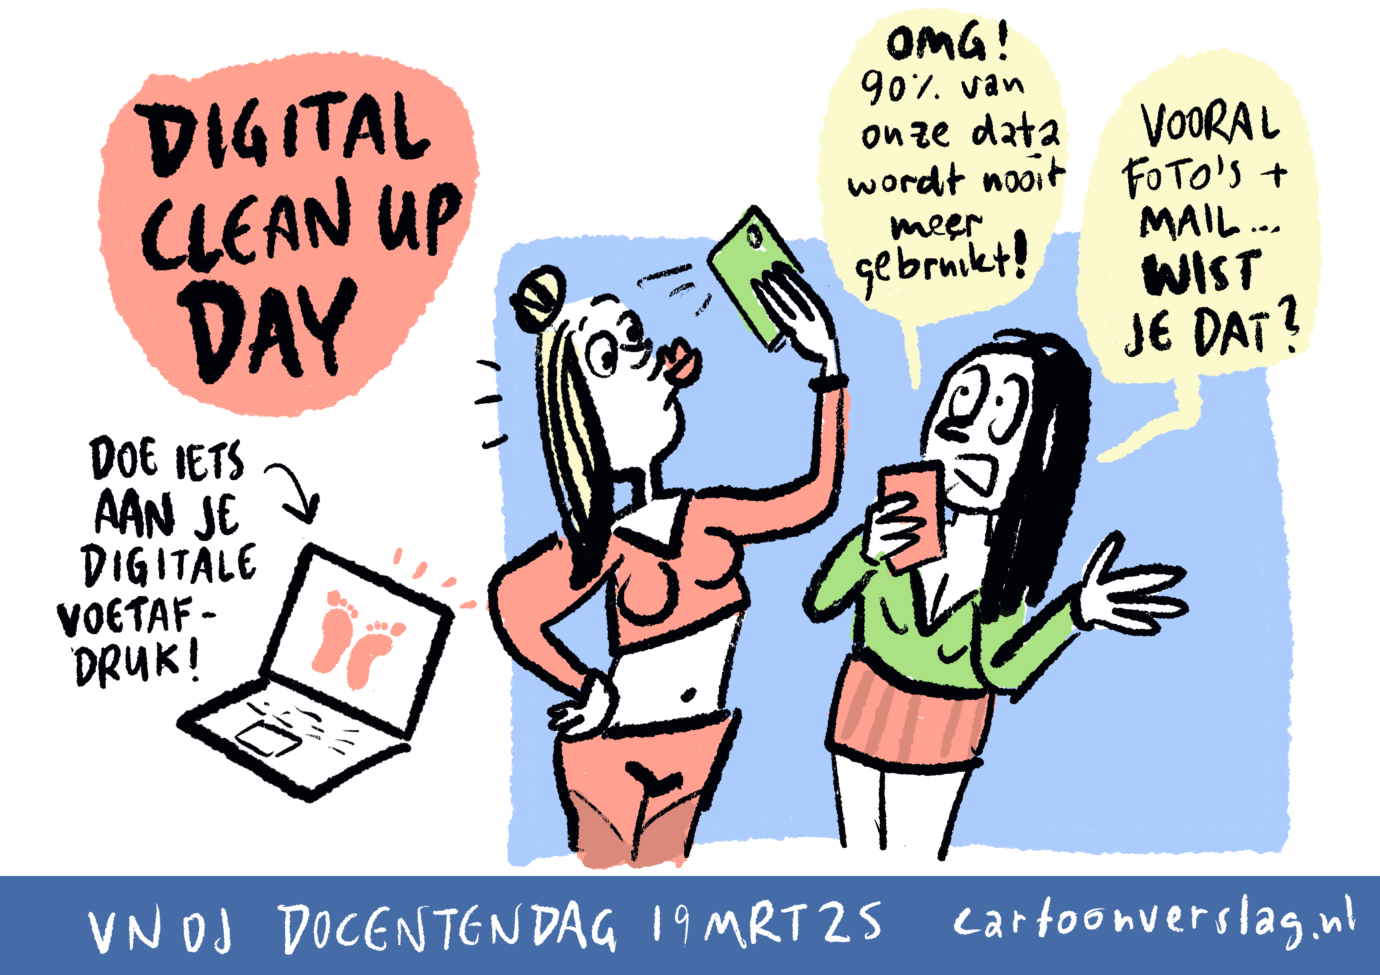
HOW?
o Create awareness. Make sure they open their eyes

Slide 11
HOW?
o Create awareness. Make sure they open their eyes.
o Make it small and tangible. But not too cautious!

Slide 12
HOW?
o Create awareness. Make sure they open their eyes
o Make it smart, small and tangible.
o Dosage and tone of voice

Slide 13
WHEN?
WHO?
Now.
Us.

Slide 14
FINE
Harmen Groenhart
Fontys University of Applied Sciences
h.groenhart@fontys.nl

